Slide 1

SmartFarm Connect
Revolutionizing African Agriculture Through Technology

Slide 2
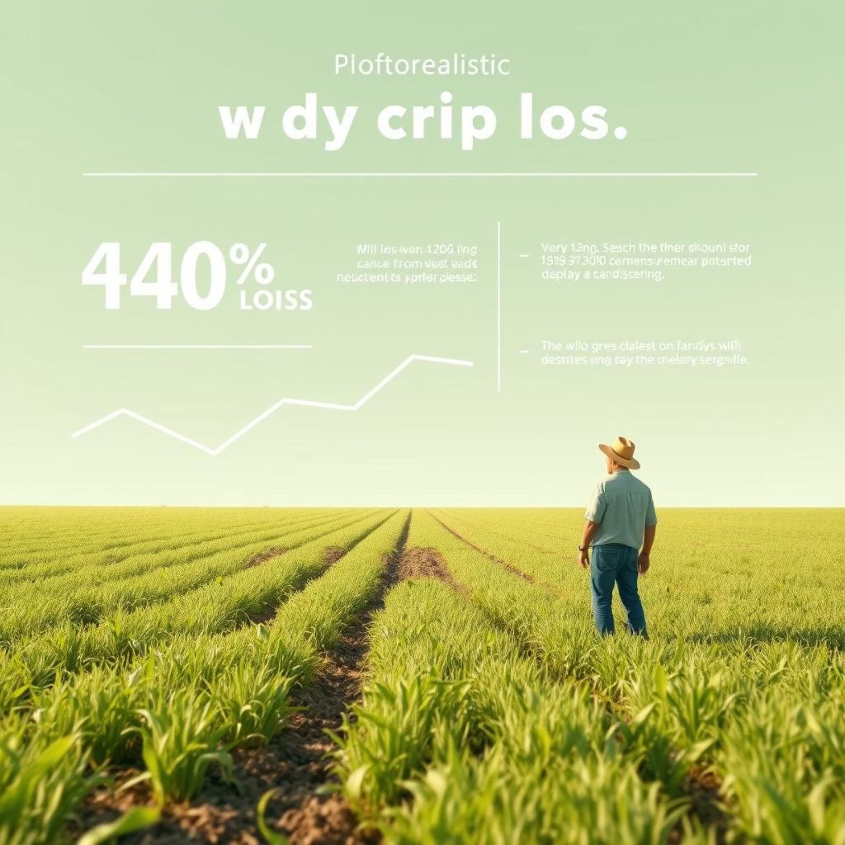
The Problem: Crop Loss in Africa
40% of African harvests are lost annually. Farmers lack crucial weather data, tailored agricultural advice, and direct market access.

Slide 3
Our Solution: SmartFarm Connect
SmartFarm Connect is an all-in-one mobile platform designed for farmers.
Local Weather Forecasts
Personalized Advice
Accurate, real-time weather predictions.
Tailored agricultural recommendations.
Direct Market Access
User-Friendly Interface
Connects farmers with buyers and cooperatives.
Simple, multilingual, and audio-enabled.

Slide 4
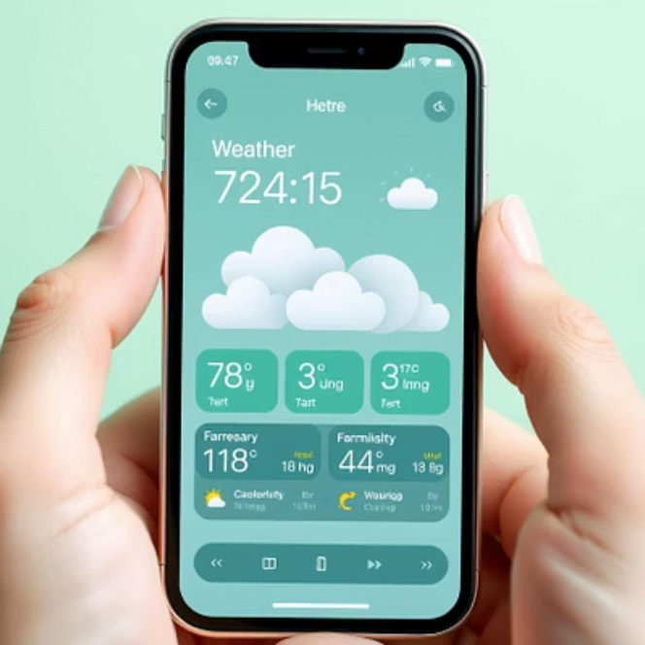
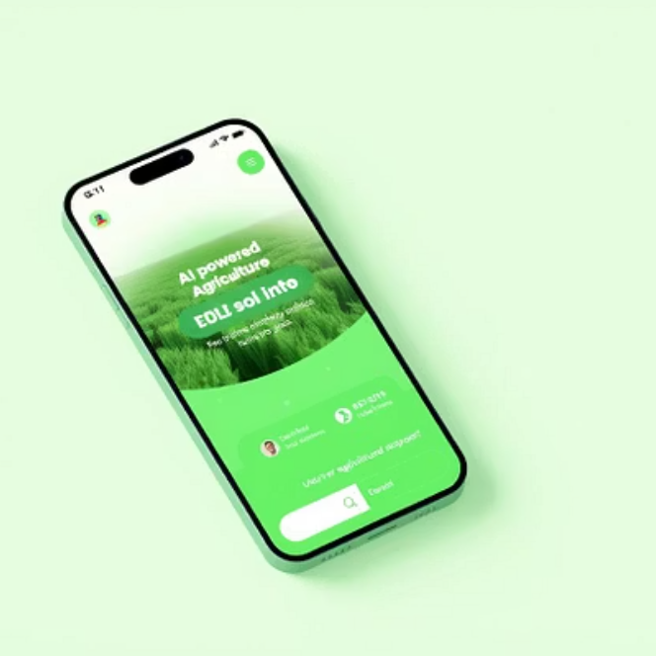
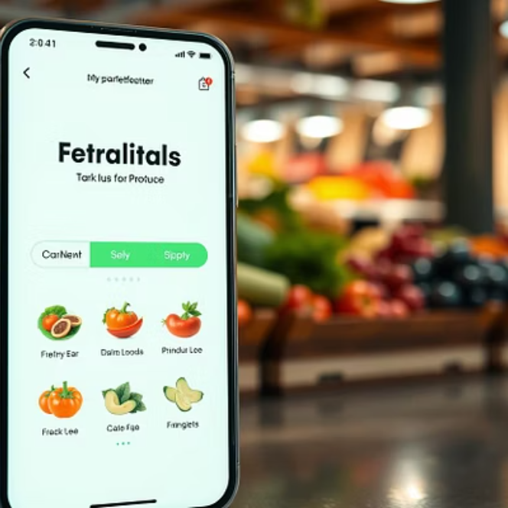
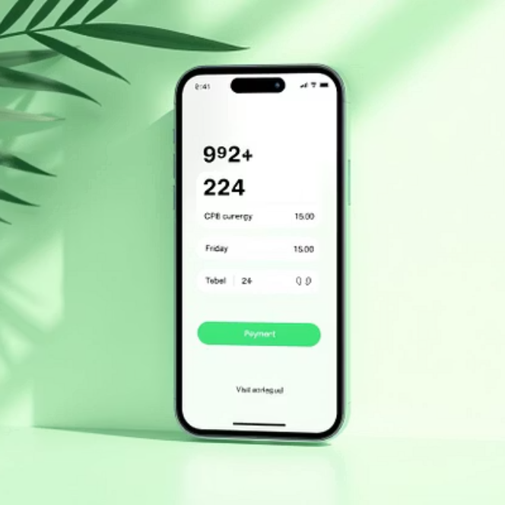
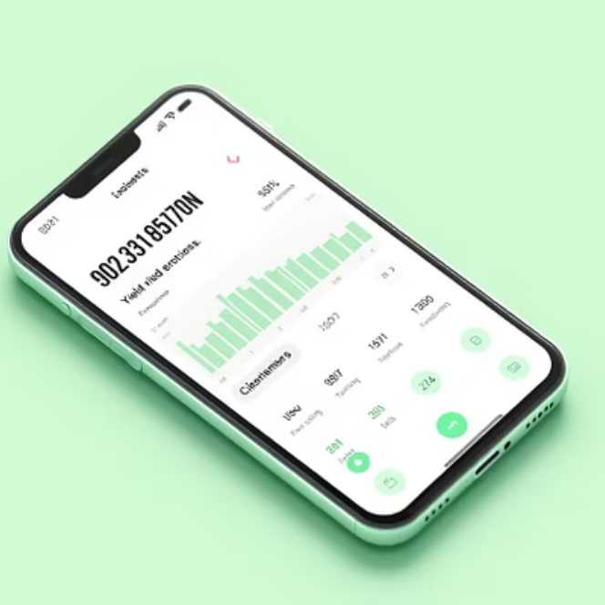
Key Product Features

Slide 5
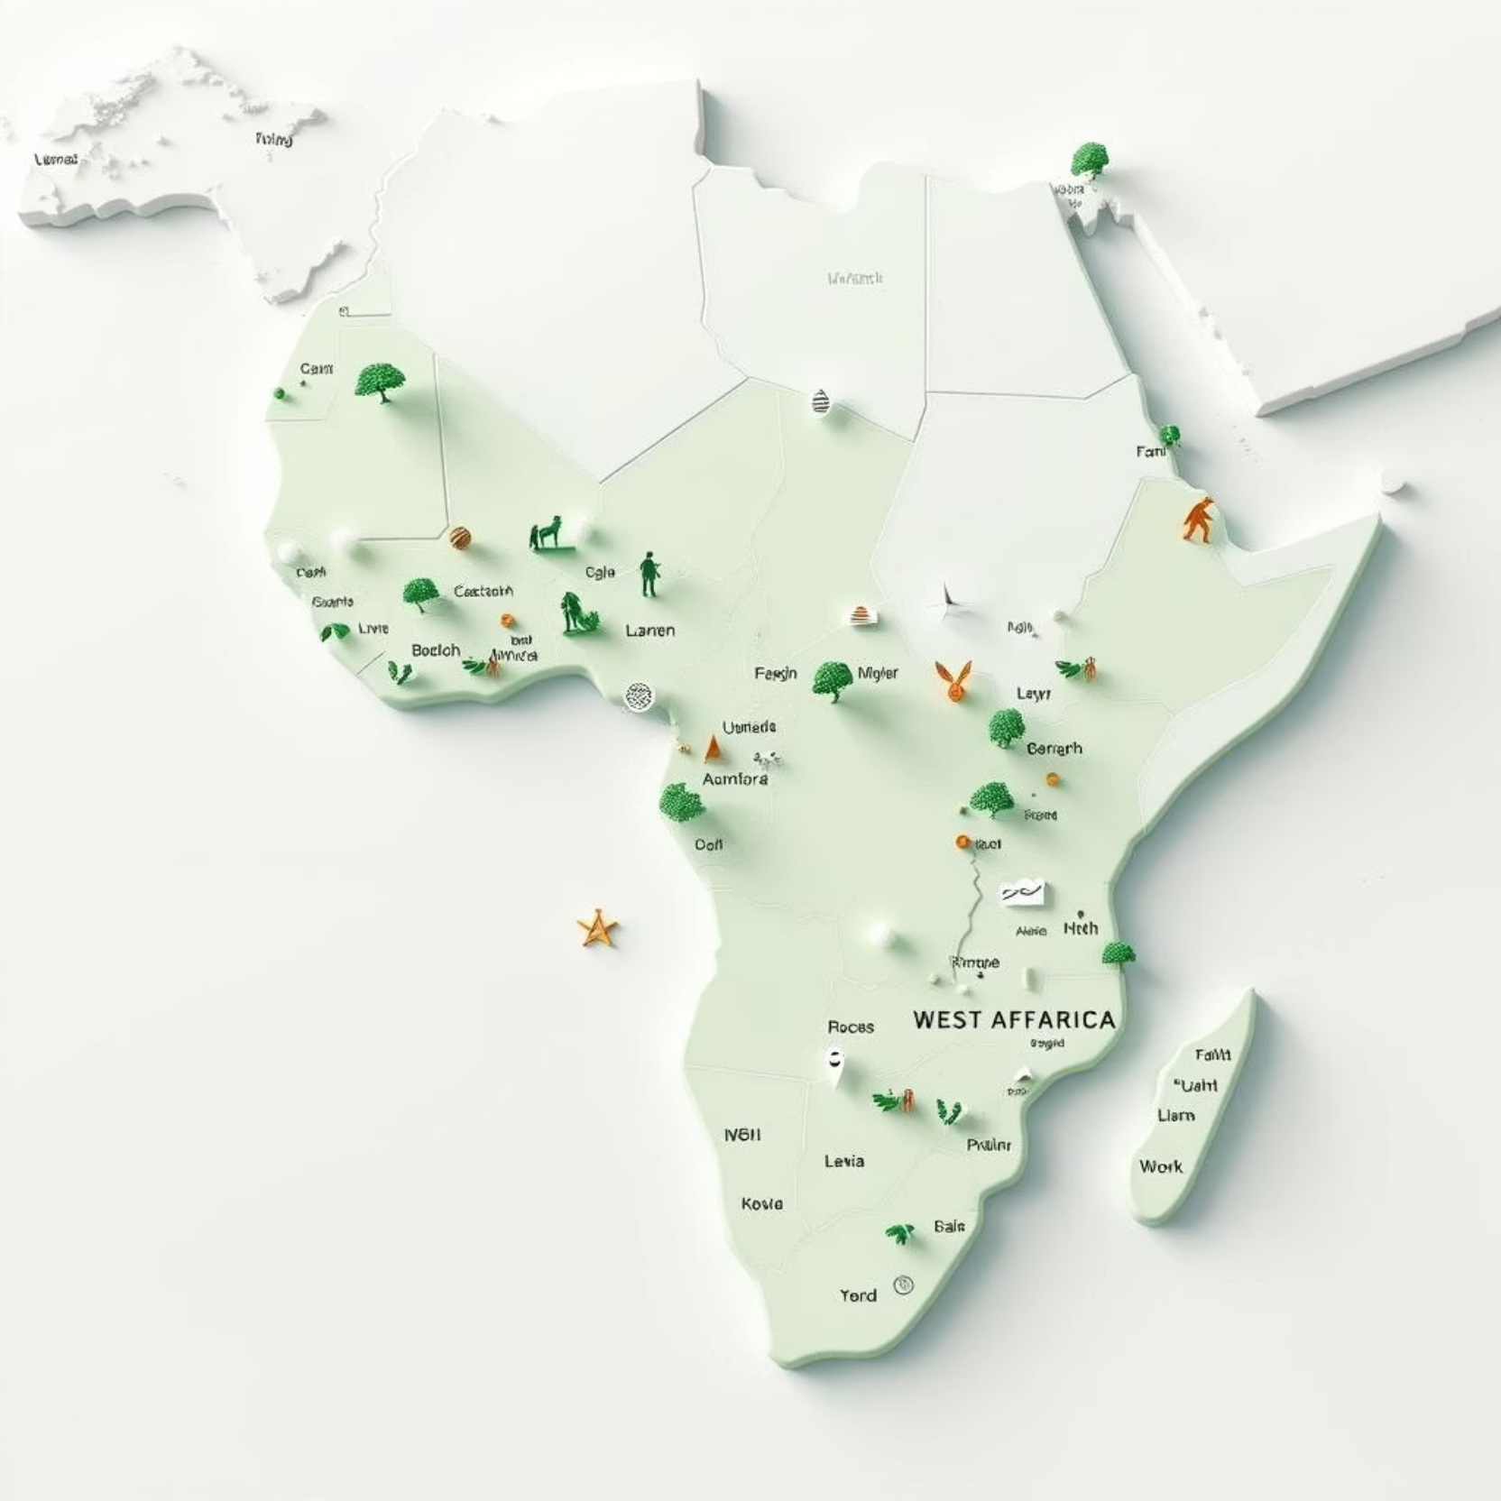
Target Market
Our initial users include:
Small farmers in Togo, Ghana, Benin
Agricultural cooperatives
Agricultural NGOs
Local agricultural produce buyers

Slide 6
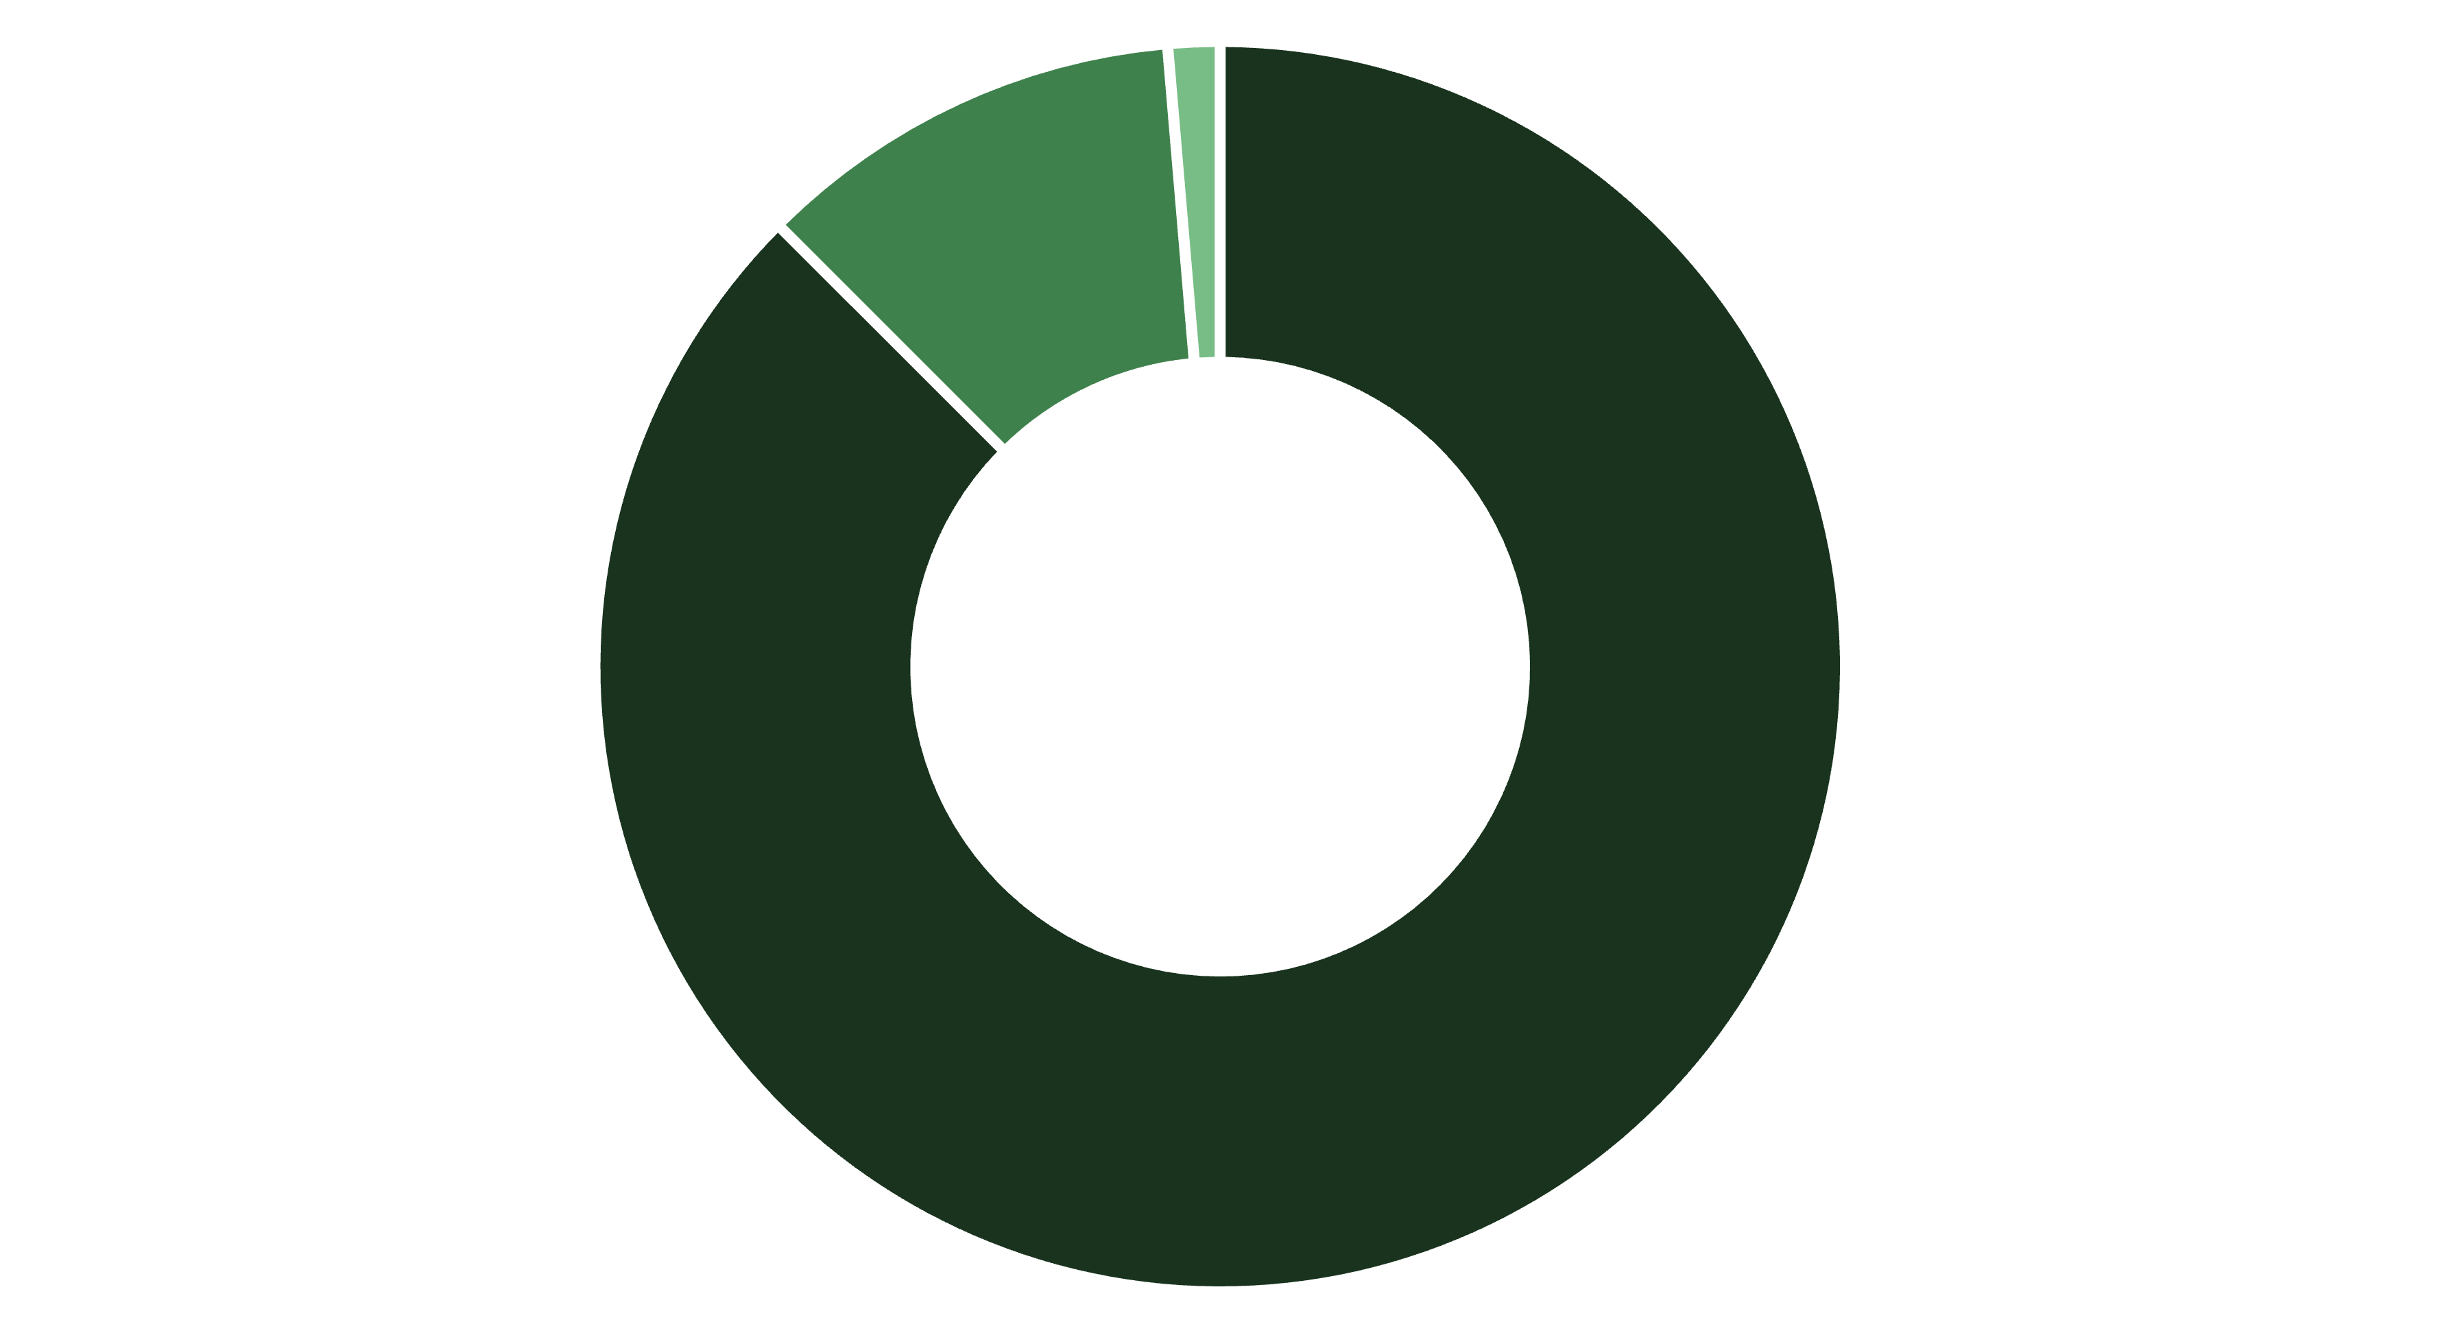
Market Size: TAM, SAM, SOM
TAM (Total)
SAM (West Africa)
SOM (Targeted Countries)
Our Total Addressable Market (TAM) includes 400 million farmers across Africa. The Serviceable Available Market (SAM) in West Africa is 50 million, with a Serviceable Obtainable Market (SOM) of 5 million in our three target countries.

Slide 7
Competitive Landscape
SmartFarm Connect
AgroInfo App
M-Farm
Strengths: Personalized advice, local integration, user-friendly interface.
Limitations: ❌ No personalized advice, ❌ limited local integration.
Limitations: ❌ Interface not adapted to rural realities, ❌ general weather platforms.

Slide 8




Competitive Advantage
Voice & Local Languages
Offline Functionality
Accessible support in native dialects.
Works without internet access.
AI Soil & Weather Recommendations
Direct & Secure Connections
Tailored advice based on specific conditions.
Facilitates safe market linkages.

Slide 9
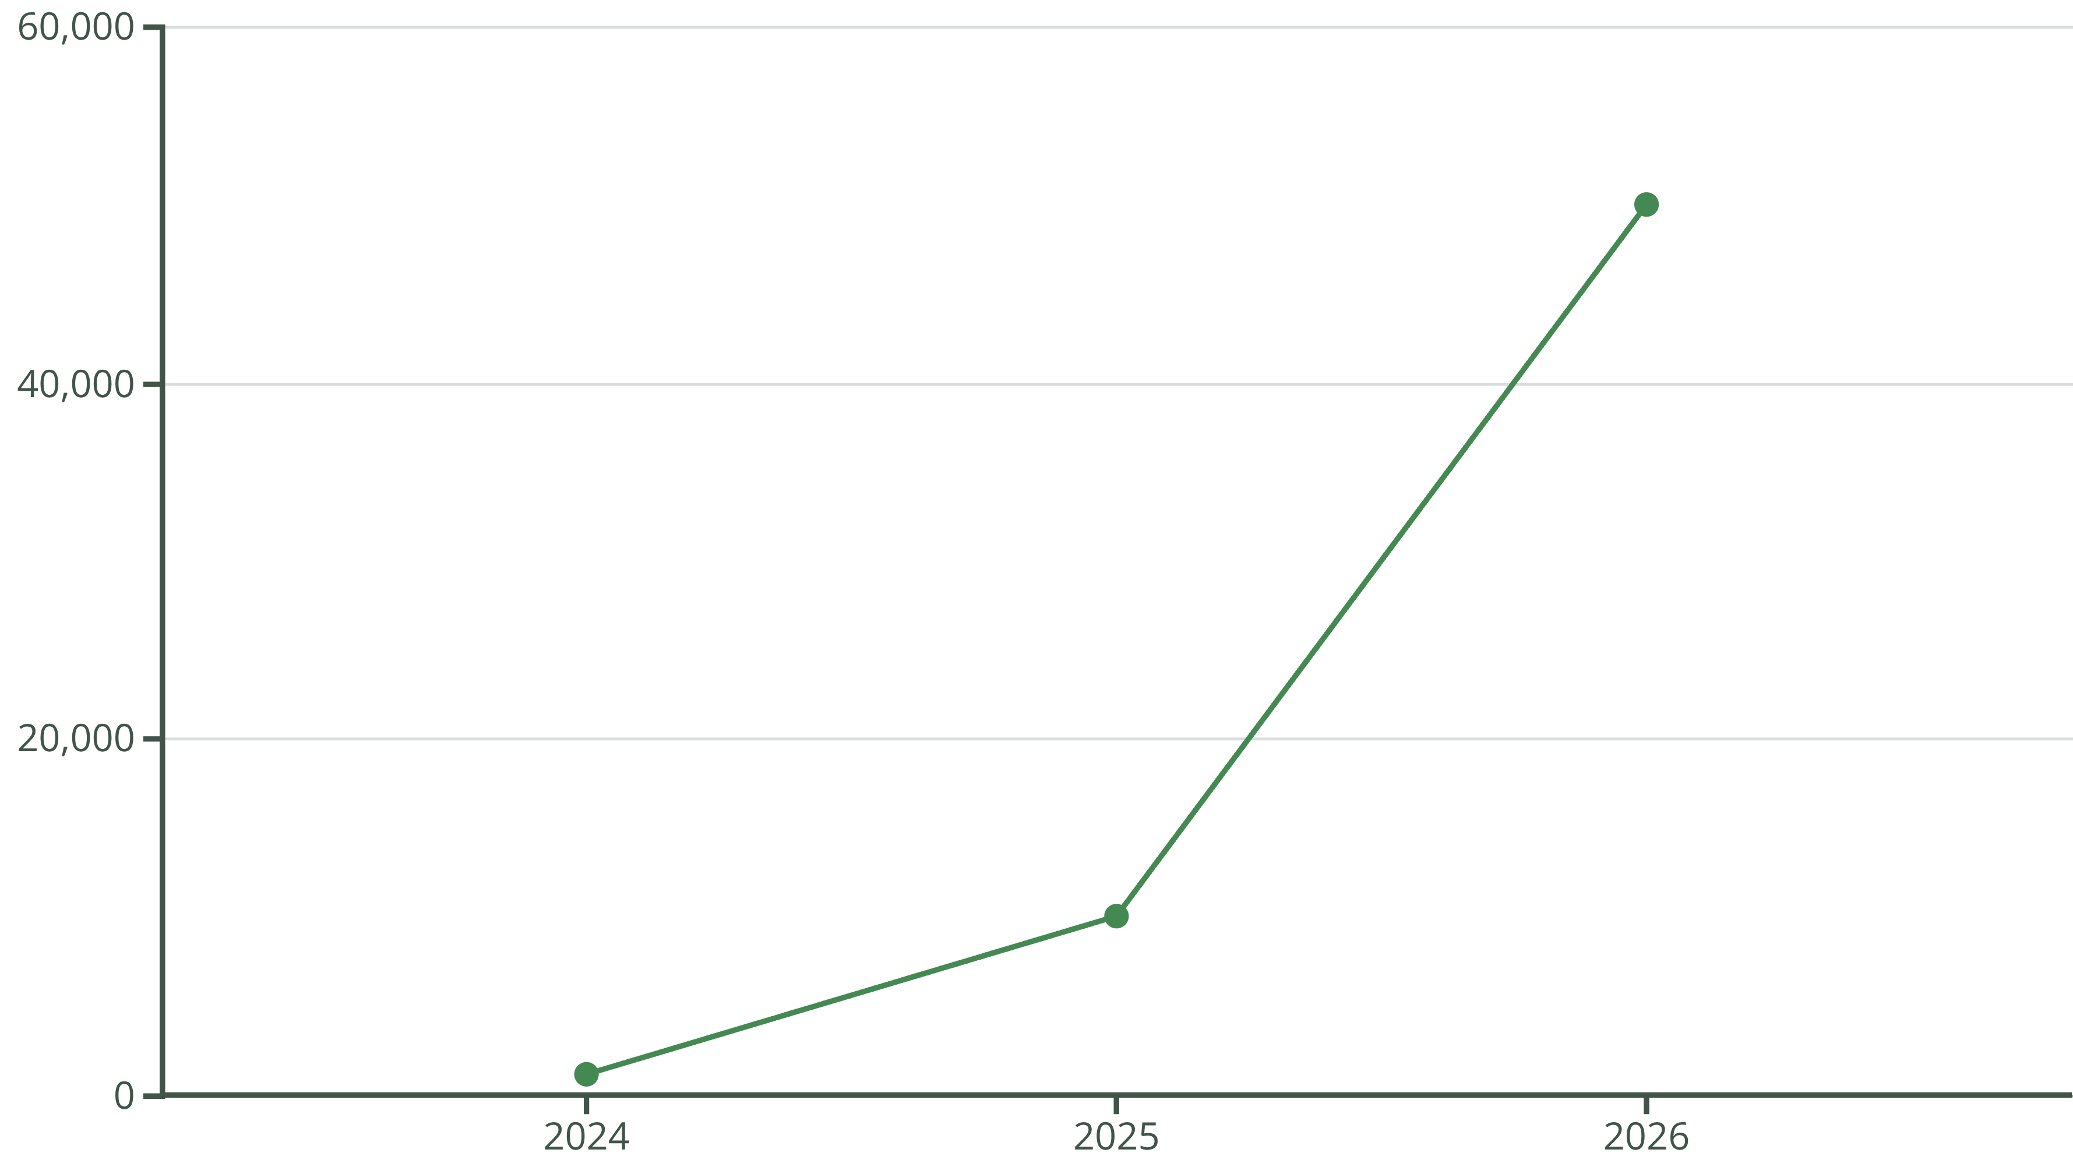
Traction & Roadmap
Our MVP has been tested in Togo with 1,200 users and we have 2 cooperative partners. Our goal is to reach 50,000 users by the end of 2026, with expansion into Benin and Ghana planned for 2026.

Slide 10
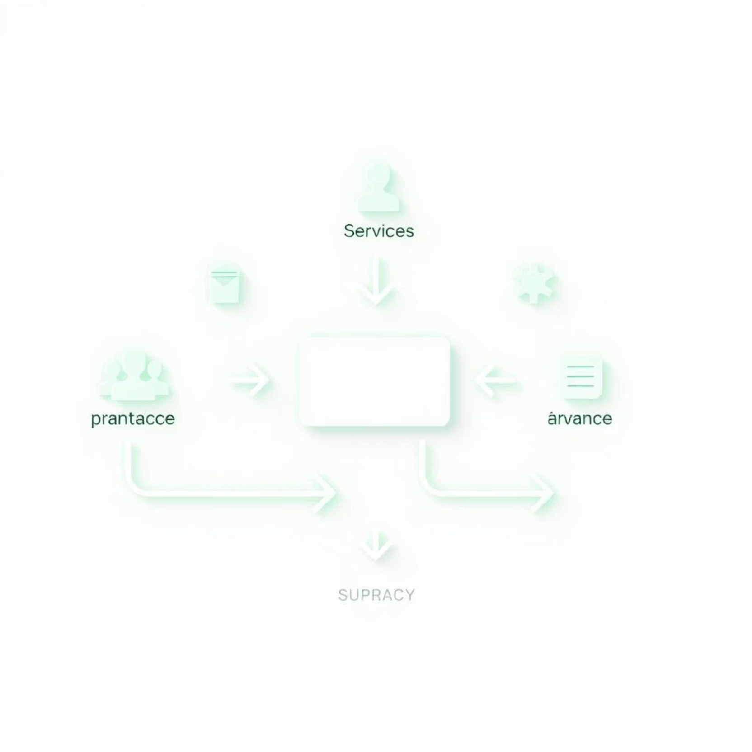
Business Model
Freemium model for small farmers.
Premium subscription: 1000 FCFA/month.
2% commission on sales.
B2B revenue from NGOs and cooperatives.

Slide 11
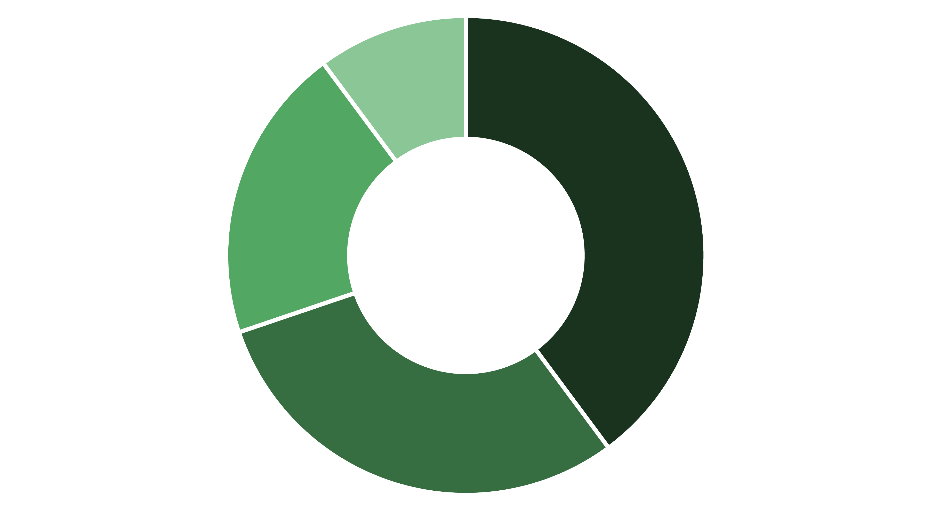
Notre demande (Our Ask)
Nous recherchons 25 000 000 FCFA pour :
Développement technique
Marketing et déploiement te...
Installation de stations mé...
Administration et support
40% : développement technique
30% : marketing et déploiement terrain
20% : installation de stations météo locales
10% : administration et support

Slide 12



L’équipe(Team)
Mr FOLLYKOE Messanh Jules
Mr Charles EKOUE
Mme Viviane Kokoe
Agronome expert du terrain
Responsable marketing rural
Fondateur, développeur full-stack
Une équipe passionnée par la transformation agricole en Afrique.

